Slide 1

Chapter 15
Networks

Slide 2
Chapter Goals (1 of 2)
Describe the core issues related to computer networks
List various types of networks and their characteristics
Explain various topologies of local-area networks
Explain why network technologies are best implemented as open systems
Compare and contrast various technologies for home Internet connections

Slide 3
Chapter Goals (2 of 2)
Explain packet switching
Describe the basic roles of various network protocols
Explain the role of a firewall
Compare and contrast network hostnames and IP addresses
Explain the domain name system
Describe cloud computing and its benefits

Slide 4
Networking (1 of 4)
Computer Network
A collection of computing devices connected in order to communicate and share resources
Connections between computing devices can be physical, using wires or cables, or wireless, using radio waves or infrared signals
Can you name some of the devices in a computer network?

Slide 5
Networking (2 of 4)
Node (host)
Any device on a network
Data Transfer Rate (bandwidth)
The speed with which data is moved from one place to another on a network
Why is bandwidth so key?

Slide 6
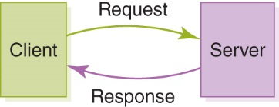
Networking (3 of 4)
Computer networks have opened up an entire frontier in the world of computing called the client/server model
Client/server interaction

Slide 7
Networking (4 of 4)
Protocol
A set of rules that defines how data are formatted and processed on a network
File Server
A computer dedicated to storing and managing files for network users
Web Server
A computer dedicated to responding to requests for web pages
P2P Model
A decentralized approach that shares resources and responsibilities among many “peer” computers

Slide 8
Types of Networks (1 of 5)
Local-Area Network (LAN)
A network that connects a relatively small number of machines in a relatively close geographical area
Ring Topology Connects all nodes in a closed loop on which messages travel in one direction
Star Topology Centers around one node to which all others are connected and through which all messages are sent
Bus Topology Nodes are connected to a single communication line that carries messages in both directions

Slide 9
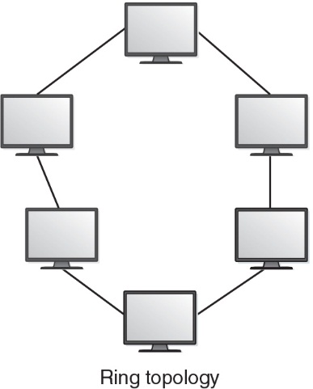
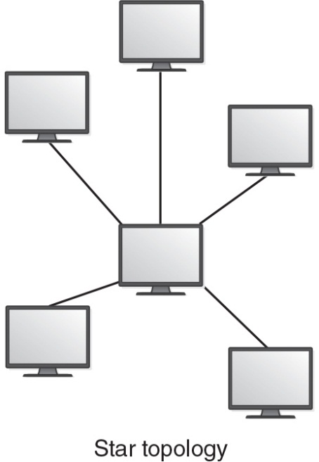
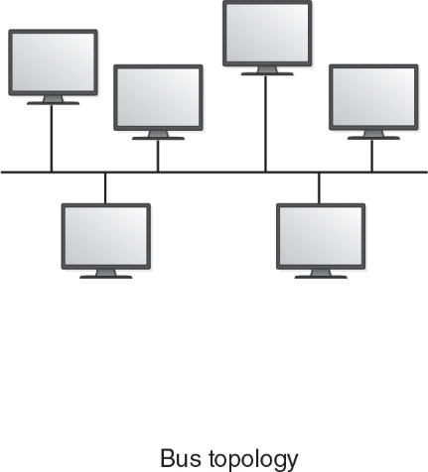
Types of Networks (2 of 5)
Network topologies

Slide 10
Types of Networks (3 of 5)
Wide-Area Network (WAN)
A network that connects local-area networks over a potentially large geographic distance
Metropolitan-Area Network (MAN)
The communication infrastructures that have been developed in and around large cities
Gateway
One particular set up to handle all communication going between that LAN and other networks

Slide 11
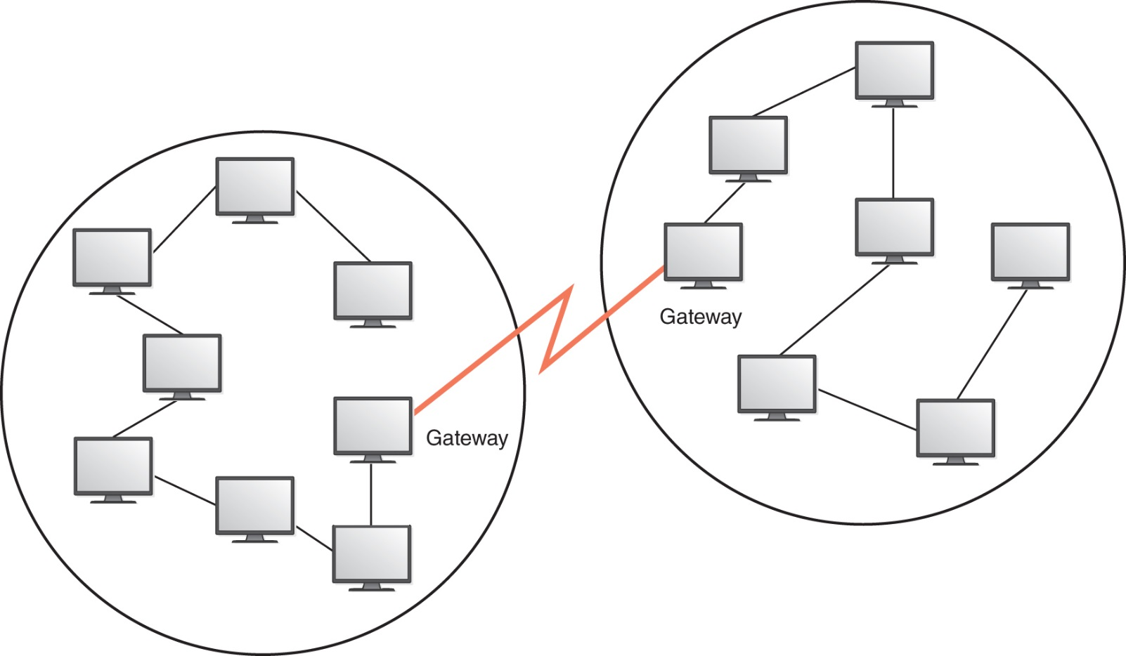
Types of Networks (4 of 5)
Local-area networks connected across a distance to create a wide-area network

Slide 12
Types of Networks (5 of 5)
Internet
A wide-area network that spans the planet
So, who owns the Internet?

Slide 13
Internet Connections (1 of 4)
Wireless Network
A network in which devices communicate with other nodes through a wireless access point
Bluetooth
A technology used for wireless communication over short distances

Slide 14
Internet Connections (2 of 4)
Latency
The time between the transmission and its receipt
Internet Backbone
A set of high-speed networks that carry Internet traffic, provided by companies such as AT&T, Verizon, GTE, British Telecom, and IBM
Internet Service Provider (ISP)
An organization providing access to the Internet

Slide 15
Internet Connections (3 of 4)
Phone modem (historical) converts computer data into an analog audio signal for transfer over a telephone line, and then a modem at the destination converts it back again into data
Digital subscriber line (DSL) uses regular copper phone lines to transfer digital data to and from the phone company's central office
Cable modem uses the same line that your cable TV signals come in on to transfer the data

Slide 16
Internet Connections (4 of 4)
Broadband
A connection in which transfer speeds are at least 25 megabits per second (Mbps)
DSL connections and cable modems are broadband connections
The speed for downloads (getting data from the Internet to your home computer) are usually not the same as uploads (sending data from your home computer to the Internet)

Slide 17
Packet Switching (1 of 2)
Packet
A unit of data sent across a network
Router
A network device that directs a packet between networks toward its final destination
Packet Switching
Messages are divided into fixed-sized, numbered packets; packets are individually routed to their destination, then reassembled

Slide 18
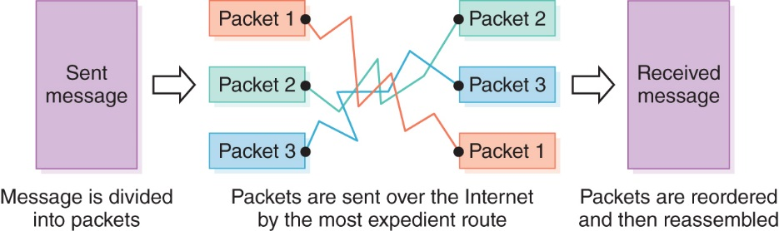
Packet Switching (2 of 2)
Messages sent by packet switching
Take a message, break it into three packets, and
simulate this process

Slide 19
Open Systems (1 of 2)
A logical progression...
Proprietary System
A system that uses technologies kept private by a particular commercial vendor
Interoperability
The ability of software and hardware on multiple machines and from multiple commercial vendors to communicate
Open Systems
Systems based on a common model of network architecture and a suite of protocols used in its implementation

Slide 20
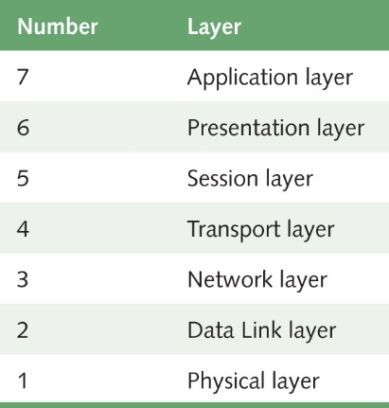
Open Systems (2 of 2)
Open Systems Interconnection Reference Model
A seven-layer logical break down of network interaction to facilitate communication standards
Each layer deals with a particular aspect of network communication
The layers of the OSI Reference Model

Slide 21
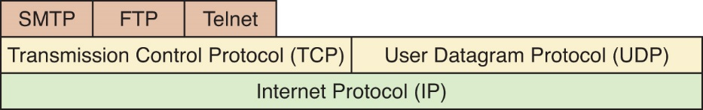
Network Protocols
Network protocols are layered such that each one relies on the protocols that underlie it
Sometimes referred to as a protocol stack
Layering of key network protocols

Slide 22
TCP/IP (1 of 2)
Transmission Control Protocol (TCP)
Software that breaks messages into packets, hands them off to the IP software for delivery, and then orders and reassembles the packets at their destination
Internet Protocol (IP)
Software that deals with the routing of packets through the maze of interconnected networks to their final destination

Slide 23
TCP/IP (2 of 2)
User Datagram Protocol (UDP)
An alternative to TCP that is faster but less reliable
Ping
A program used to test whether a particular network computer is active and reachable
Traceroute
A program that shows the route a packet takes across the Internet

Slide 24
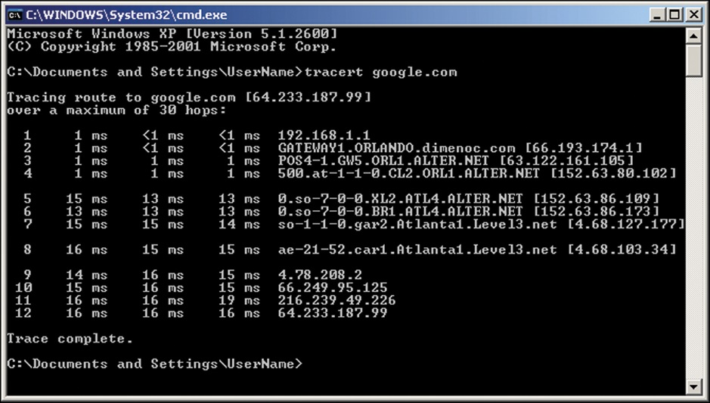
Traceroute in Action
The traceroute utility
Used with permission from Microsoft.

Slide 25
High-Level Protocols (1 of 2)
Other protocols build on TCP/IP protocol suite
Simple Mail Transfer Protocol (SMTP) is used to specify transfer of electronic mail
File Transfer Protocol (FTP) allows a user to transfer files to and from another computer
Telnet is used to log onto one computer from another
Hypertext Transfer Protocol (http) allows exchange of Web documents
Which of these have you used?

Slide 26
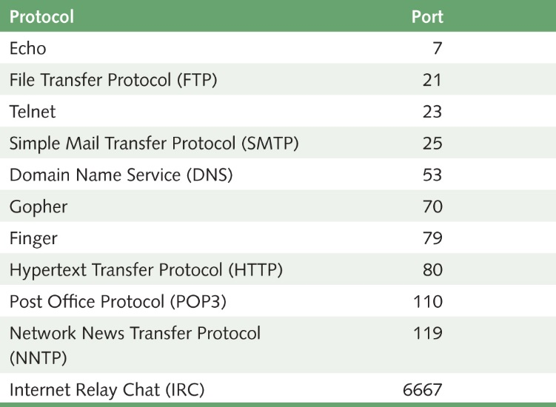
High-Level Protocols (2 of 2)
Port
A numeric
designation
that corresponds
to a particular
high-level
protocol
Some protocols and the ports they use

Slide 27
MIME Types
MIME Type
A standard for defining the format of files that are included as email attachments or on websites
What does MIME stand for?
Multipurpose Internet Mail Extension

Slide 28
Firewalls (1 of 2)
Firewall
A gateway machine and its software that protects a network by filtering the traffic it allows
Access Control Policy
A set of rules established by an organization that specifies what types of network communication are permitted and denied
Have your messages ever been
returned undelivered, blocked by a firewall?

Slide 29
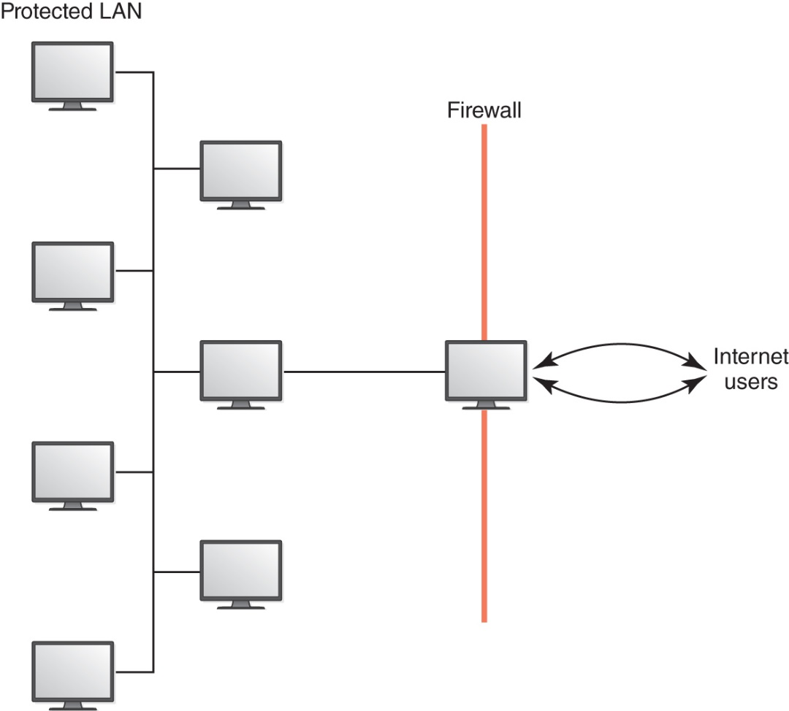
Firewalls (2 of 2)
A firewall protecting a LAN

Slide 30
Network Addresses (1 of 3)
Hostname
A name made up of words separated by dots that uniquely identifies a computer on the Internet
IP Address
An address made up of four one-byte numeric values separated by dots that uniquely identifies a computer on the Internet
Is there a correspondence between the parts of a hostname and an IP address?

Slide 31
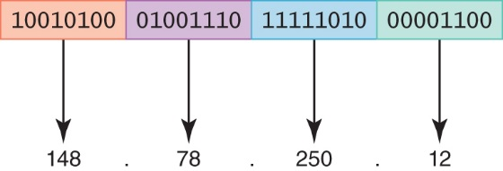
Network Addresses (2 of 3)
An IP address stored in 4 bytes
What is wrong with the IP4 strategy?
How did smartphones contribute to the problem?

Slide 32
Network Addresses (3 of 3)
IPv4
The last block was assigned in 2011
IPv6
32 bits organized into four groups of 8
FE80:0000:0000:0000:0202:B3FF:FE1E:8329
They work in parallel

Slide 33
Domain Name System (1 of 5)
Host Number
The part of the IP address that specifies a particular host (machine) on the network
Yes, but what is it?
Domain Name
The part of a hostname that specifies a specific organization or group
Top-Level Domain (TLD)
The last section of a domain name that specifies the type of organization or its country of origin

Slide 34
Domain Name System (2 of 5)
Domain Name System (DNS)
A distributed system for managing hostname resolution
Domain Name Server
A computer that attempts to translate a hostname into an IP address
Domain Squatting
Ransoming domain names
Should the tables containing hostname/IP mappings be sorted or unsorted? Why?

Slide 35
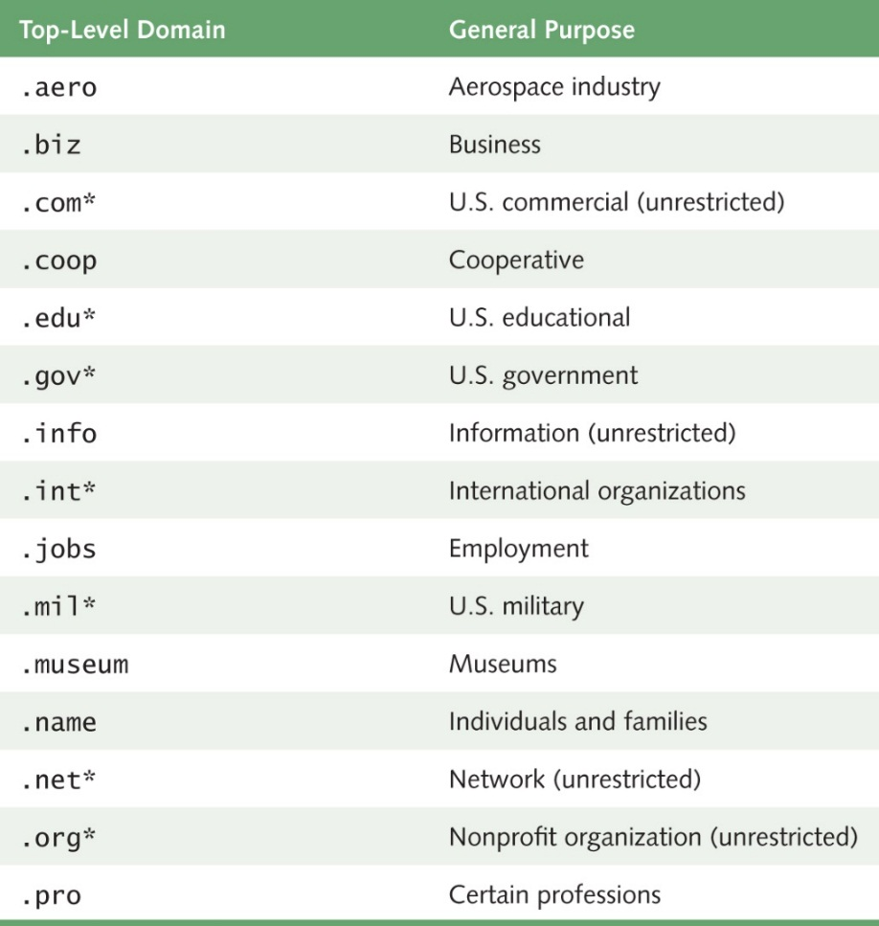
Domain Name System (3 of 5)
Some top-level domains and their general purpose (* indicates an original TLD)

Slide 36
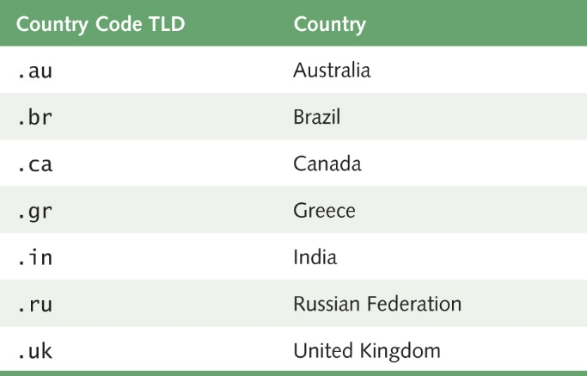
Domain Name System (4 of 5)
Organizations based in countries other than the United States may use a top-level domain that corresponds to their two-letter country codes
Some of the top-level domain names based on country codes

Slide 37
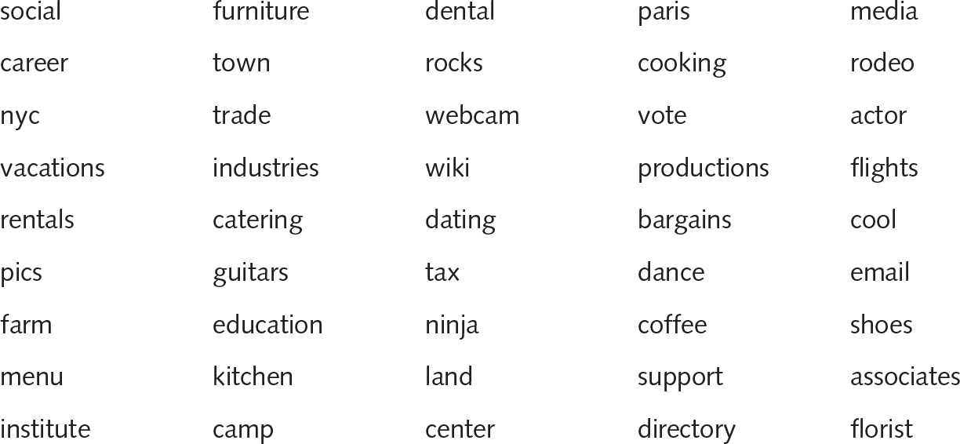
Domain Name System (5 of 5)
Here are a few of the many TLDs that are available:

Slide 38
Who Controls the Internet?
Control of IP Addresses and Domain Names
Internet began as ARPANET, a project of the U.S. Department of Defense
Control subcontracted to ICANN in 1998
U.S. government to further reduce role as early as 2015
FCC Proposal
Would allow ISPs to provide “premium” access to certain customers, perhaps by deliberately slowing down data transfer for others
Net neutrality The principle that ISPs should deliver data to everyone equally, as fast as the technology allows

Slide 39
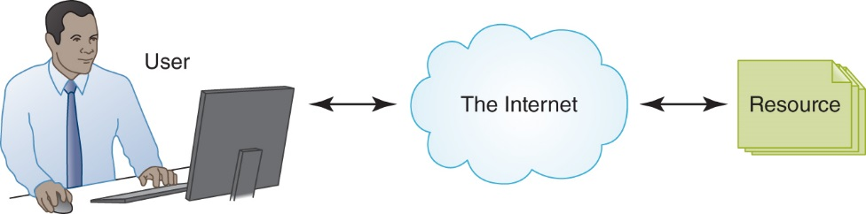
Cloud Computing
A paradigm in which resources (computers, storage, etc.) are provided by a third party and managed through Internet communication
Example: Google's Gmail
Popular providers of cloud computing: Amazon Web Services, Google Cloud, and Microsoft Azure
Internet communication depicted using a cloud

Slide 40
Types of Cloud Services
Public clouds are accessible by any subscriber
Private clouds are established for a specific group or organization
Community clouds are shared among two or more organizations with the same needs
Hybrid clouds are some combination of the others

Slide 41
Blockchain
A network-based technology that acts like a public ledger, recording important economic transactions
Once verified, a transaction is added to a block of transactions, which is added to the chain of ongoing sequential transactions
Blockchain is considered incorruptible—it is decentralized and self-auditing
There is no single point of failure and it cannot be controlled by any single entity

Slide 42
Ethical Issues
Effects of Social Networking
What are some examples of popular social networking sites?
Who uses social networking?
What are the benefits and the disadvantages of using these social networking sites?
Do the benefits of social networking outweigh the potential costs?

Slide 43
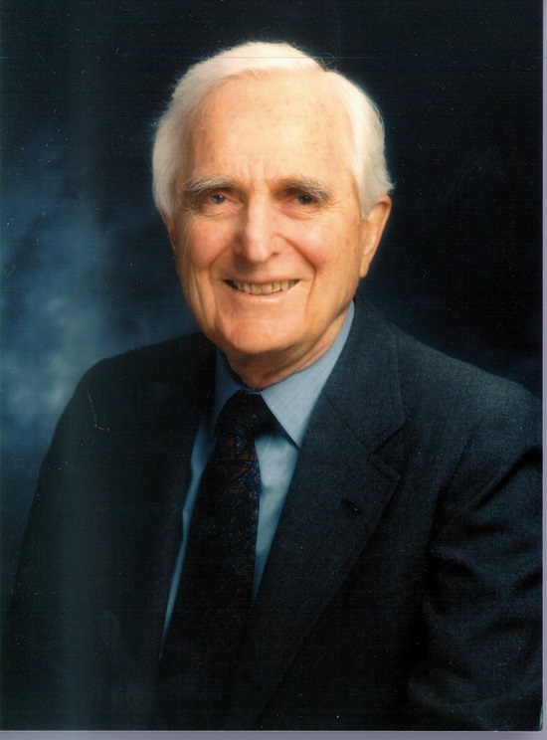
Who Am I?
What two major
awards did
I win?
For what
were they
given?
Courtesy of the Doug Engelbart Institute

Slide 44
Do You Know?
What is SETI? What does it have to do with extraterrestrials?
What is a protocol?
For what did Bill Gates receive a Knighthood from Queen Elizabeth?
The Kernel suggested that the causes of death for a South Korean man in 2005 and a Taiwanese man in 2012 were the same. What was the suggested cause?

